Slide 1
THE SPARTANS

Slide 2
Archaic Age (c. 750 – c. 500 BCE)
This new period saw the creation of the polis (=city), an independent community of citizens inhabiting a city and the countryside around it.
The polis was different form earlier, monarchical city-states because it was a community of citizens, non subjects, who usually governed themselves under various different political systems

Slide 3
Greece’s geography, characterized by mountains and islands, promoted the creations of many separate independent city states

Slide 4
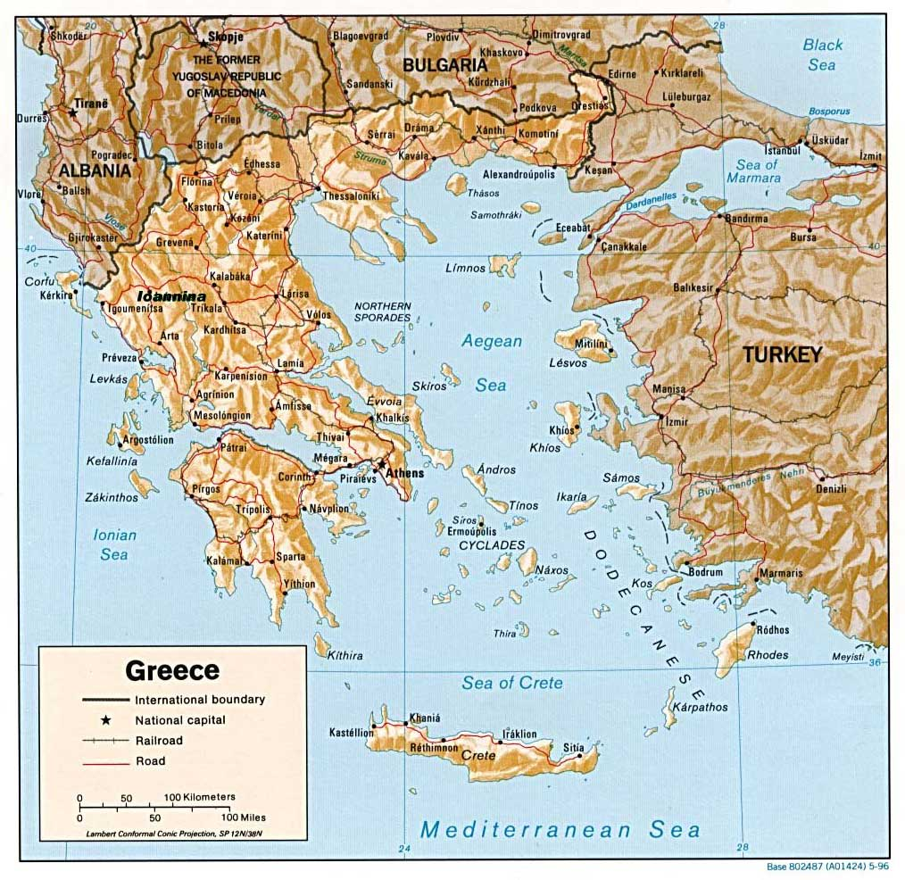

Slide 5
Greek city-states developed three forms of society and government: oligarchy, tyranny and democracy
Oligarchy is a political system in which a small number of men controlled policymaking in an assembly of male citizens
Sparta provided the most famous example of an oligarchy

Slide 7
Military readiness overrode all other concerns in Sparta. The Spartans were renowned for their militaristic self-discipline
Sparta is located in an easily-defended valley on the Peloponnese peninsula 25 miles from the coast. This separation from the coast kept the Spartans from becoming sailors. Their strength was on land and they were able to create the best infantry force in Greece

Slide 8
The Spartan version of oligarchy included three components of rule.
First came two leaders, called kings, who served as the state’s religious heads and the generals of its army.
Despite their title, they were not monarchs but only part of the ruling oligarchy

Slide 9
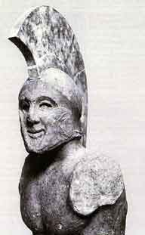
Leonidas (Leo’s son)

Slide 10
The other two parts were a council of 28 men over sixty years old (the elders) and five annually elected magistrates called overseers. In theory, legislation had to be approved by an assembly of all Sparta’s free men, but the assembly had only limited power over the proposals put before it.
The council could resubmit a proposal after seeking support for its passage

Slide 11
All Spartans citizens were expected to put service to their city-state before personal concerns because the survival of Sparta was continually threatened by its own economic foundation: the great mass of Greek slaves, called Helots, who did almost all the work for the free inhabitants of Sparta
Helots were captives (and descendants of captives) from neighboring parts of Greece that the Spartans conquered. They outnumbered the free citizens of Sparta. They belonged to the whole community

Slide 12
Helots could have a semblance of family life because they were expected to produce children in order to maintain their population.
They worked as farmers and household slaves so that Spartan free citizens would not have to do such nonmilitary work.
Helots lived under the constant threat of officially sanctioned violence. Every year the council declared war between Sparta and the Helots, allowing any free man to kill a Helot

Slide 13
By beating the Helots frequently, forcing them to get drunk in public as a lesson to young Spartans and forcing them to wear humiliating caps, the free men of Sparta emphasized the otherness of the Helots
In this way Spartans created a moral barrier to justify their superiority and their harsh abuse of fellow Greeks
To emphasize the difference from the Helots, Spartan men wore their hair very long to show that they were warriors

Slide 14
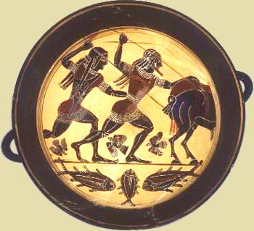

Slide 15
Because the Helots did all the manual labor, free Spartan men could devote their whole lives to full-time preparation for war.
Boys lived at home only until their seventh year, when they were sent to live in communal buildings with other males until they were thirty.
Adults ate at common meals with the other free men.

Slide 16
The boys learned to call all older men Father to emphasize that their primary loyalty was to the group instead of his biological family.
Discipline was very strict and those who could not survive the tough conditions of the training fell into social disgrace.

Slide 17
Spartan women were known in the entire Greek world for their personal freedom. Since their husbands were rarely at home, Spartan women directed the households.
They could own property, including land. Wives were expected to use their freedom from manual labor to keep themselves physically fit so that they could bear healthy children. They were also expected to teach Spartan values to their children.
“Come back with this shield or on it”

Slide 18
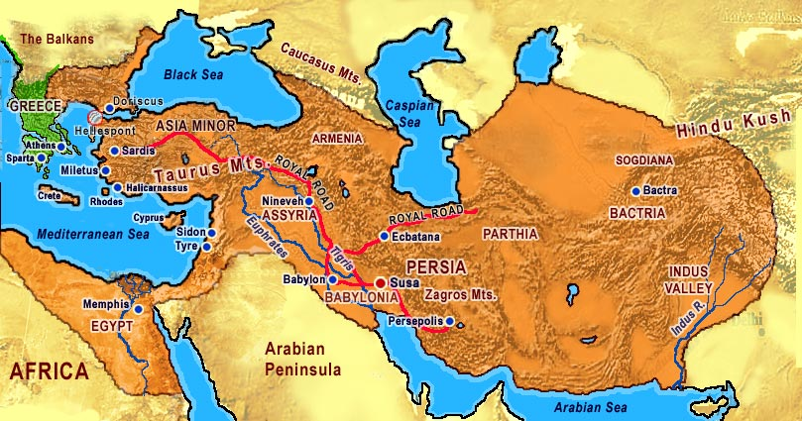
Persian Empire under Xerses

Slide 19
Battle of Thermopylae (480 BC)
King Leonidas
300 Spartan Warriors

Slide 20
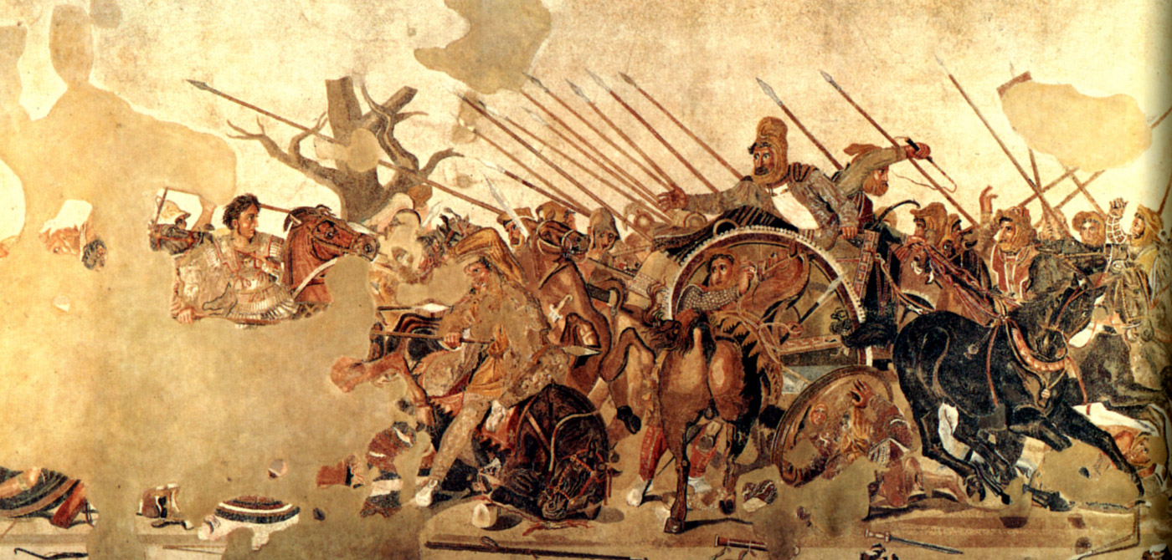
Alexander the Great and Darius III (+ 330 BC)

Slide 21
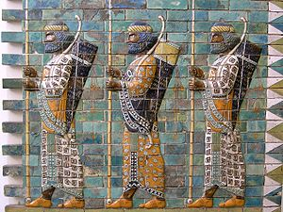
The Immortals

